Slide 1
Software Quality Assurance and Testing Technology
1st Semester, Fall 2022
Xiaoping CHE (xpche@bjtu.edu.cn)
Associate Professor
School of Software Engineering
Beijing Jiaotong University

Slide 2
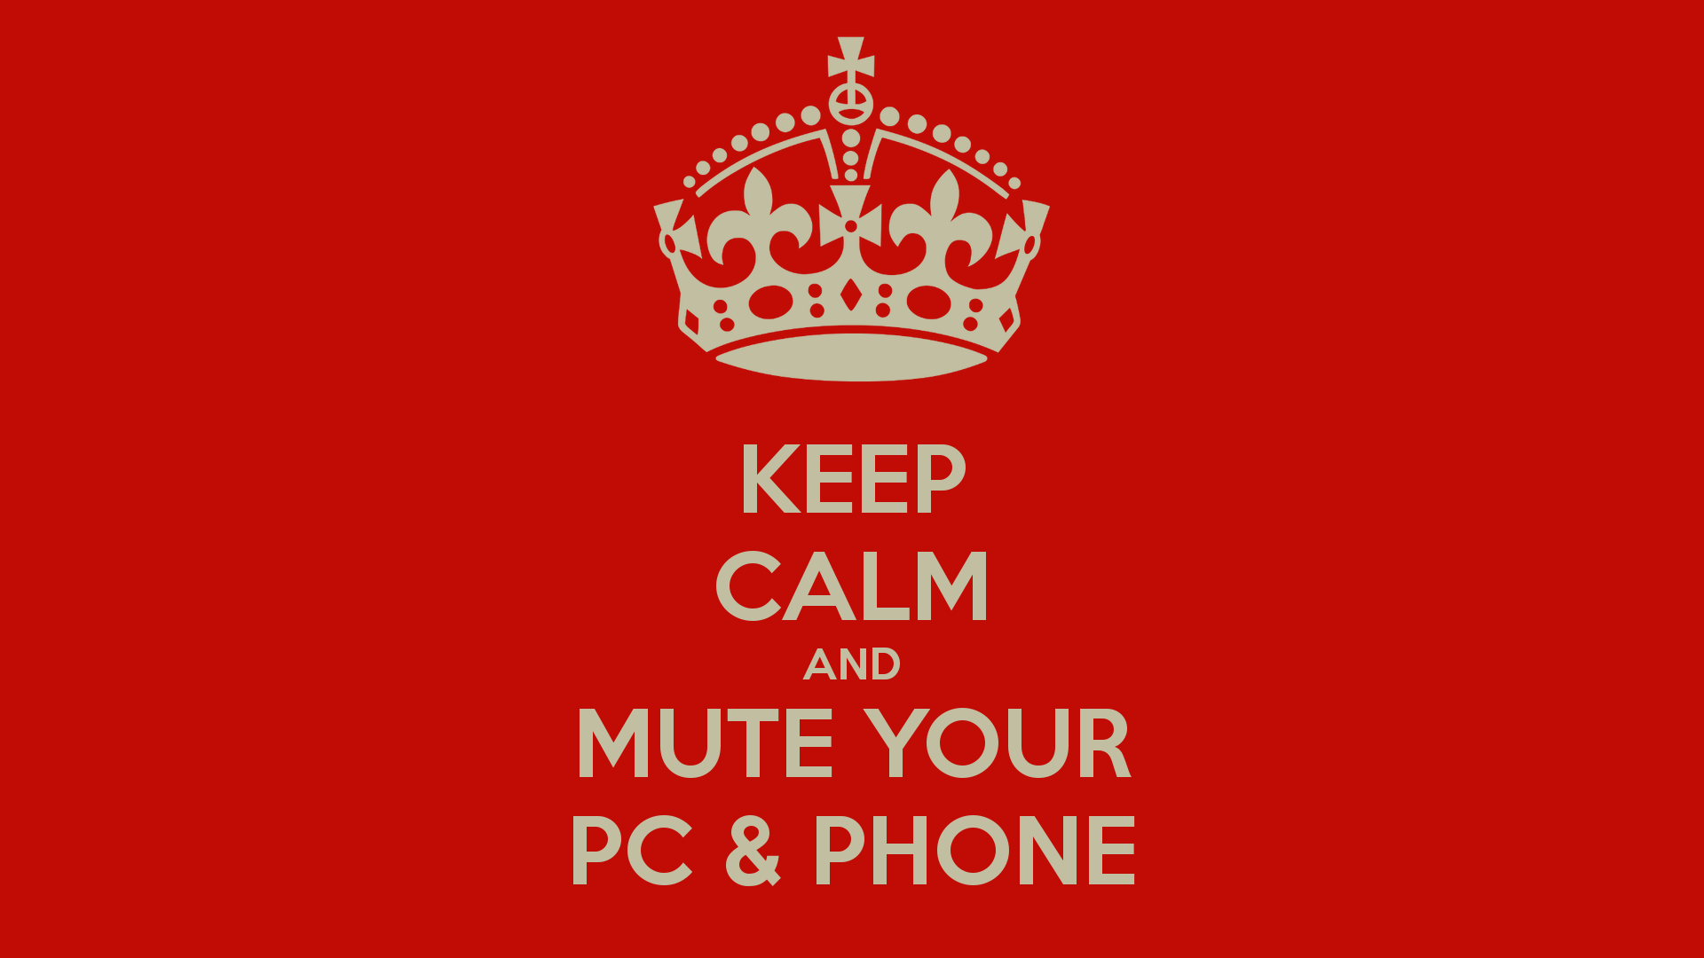



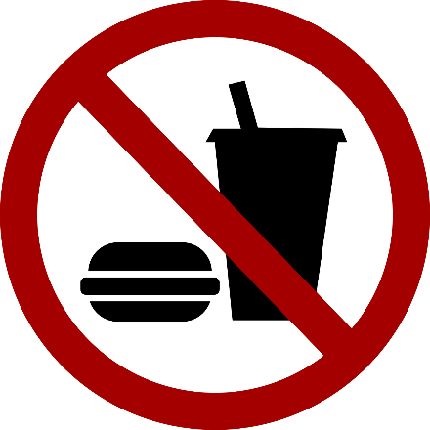
Rules

Slide 3
Rules
Project 20%
Assignments 40%
Final Exam 40%

Slide 4
How
16 Weeks Plan
Week 1: The basic concepts and theories of testing
Week 2-3: Principles of Testing
Week 4-5: White Box Testing
Week 6-7: Test Cases & Black Box Testing
Week 8-10: System Testing

Slide 5

How
References
Ron Patton, Software Testing (2th Edition)
Glenford J. Myers, The Art of Software Testing (3rd Edition)
Gerald M. Weinberg, Perfect Software

Slide 6
Two Approaches
Running
Running
Test Driver
Tested Module
=main()
call
Tested Module
Test Stub
a special-purpose program to simulate the activity of the missing component
Driver: component that calls component to be tested
Stub: component called by component to be tested

Slide 7
Unit test procedure
Driver
interface
local data structures
boundary conditions
independent paths
error-handling paths
Component
to be tested
Results
Test cases
Stub
Stub
driver and/or stubs must be developed for each unit test

Slide 8
Unit test procedure
public class unittest{
//Test driver
public static void main(String[] args) {
unittest d = new unittest();
d.Add();
}
//My module
public int Add() {
int output=this.Stub1() + this.Stub2();
System.out.print("My module: return value is "+output+"\n");
return output;
}
//Stub1 public int Stub1() {
int output=3;
System.out.print("Stub 1 : return value is "+output+"\n");
return output; }
//Stub2 public int Stub2() {
int output=7;
System.out.print("Stub 2 : return value is "+output+"\n");
return output; }
}

Slide 9
Integration Testing
If components all work individually, why more testing?
Interaction errors cannot be uncovered by unit testing!
(e.g., interface misuse, interface misunderstanding, timing errors)
Integration approaches
Big Bang!!
Incremental
construction
strategy
Versus
Incremental
“builds”
Regression
testing

Slide 10
Unit Tests vs Integration Tests
Unit tests – Test the pieces of code- the modules (functions, subroutines, etc.)
Integration tests – Test the program or combinations of modules.
Both of these need to be done, but two different strategies are used typically:
Bottom-up Testing
Top-down testing
Note: Mixed strategies can be used, but it is best to consider these separately.

Slide 11
Bottom-up Testing vs Top-down Testing
Bottom-up testing
Test the units as they are completed.
Debug the units.
Integrate some of the units and test the integration.
Debug the integrated units.
Continue until ....???
Note: to test the integrated units, driver code (which later may be thrown away) must be written.

Slide 12
Bottom-up Integration
A
B
C
D
E
F
G
Test E
Test B,E,F
Test A,B,C,D,E,F,G
Test F
Test C
Test G
Test D,G

Slide 13
Pros & cons
Advantage:
- Popular approach
- Is useful when many of low-level components are general-purpose utility routines that are invoked often by others
- Integrated test by component driver
- Test data and test case are created easily
Disadvantage:
- Top-level components are usually the most important but the last to be tested
- Sometimes faults in the top levels reflect faults in design, obviously, these problems should be corrected ASAP
- It is difficult to test a system from bottom up when much of the system’s processing depends on timing

Slide 14
Bottom-up Testing vs Top-down Testing
Top-down Testing
Write a top function first, such as the main function.
Write stubs to handle calls to other functions.
A stub is code that sets variables that must be returned to the calling function and may only just print something such as “In Module A”.
Test and debug the top function.
Replace the stub with actual code.
Test and debug the stub with its calling function(s).
Repeat until ... ???

Slide 15
Top-down integration
A
B
C
D
E
F
G
Test A
Test A,B,C,D,E,F,G
Test A,B,C,D

Slide 16
Pros & cons
Advantage:
- The most important components can be tested early
- Apply to top-down design and code
- Driver programs are not needed in top-down testing
- Logic and structure is clear
Disadvantage:
- A very large number of stubs (a special-purpose program to simulate the activity of the missing component) may be required
- Testing each level’s component individually introduces another difficulty

Slide 17
Modified Top-down integration
A
B
C
D
E
F
G
Test B
Test E
Test A
Test C
Test A,B.C,D
Test F
Test A,B,C,D,E,F,G
Test D
Test G

Slide 18
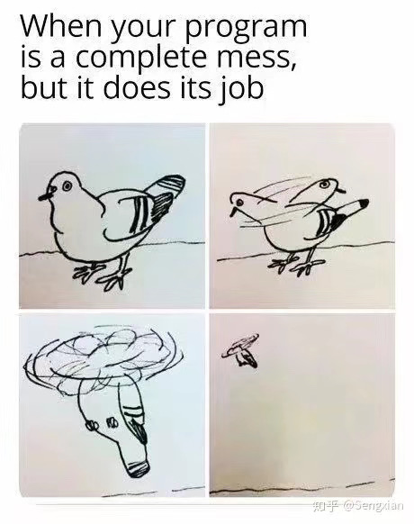
System Testing
Functional Behavior and Codes
Spec: The bird can fly…

Slide 19
System Testing
Topics in Testing Software
Usability

Slide 20
System Testing
Software Usability
Eventually a person will interact with a software system.
Software usability is how:
appropriate
functional
effective
that interaction is.
Ergonomics is the science of designing everyday things so that they are easy and functional to use.

Slide 21
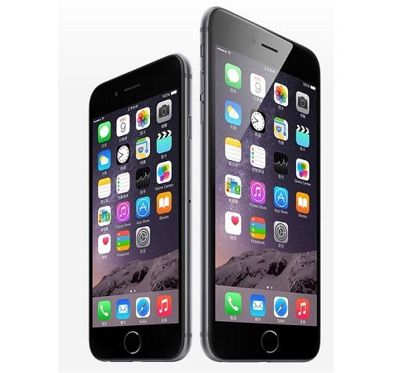
System Testing
Important traits of a good UI
Follows standards and guidelines
Intuitive
Consistent
Flexible
Comfortable
Correct
Useful

Slide 22
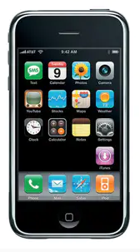
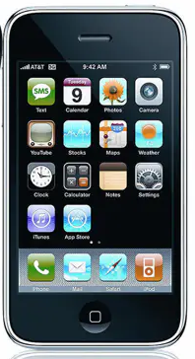
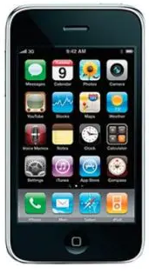
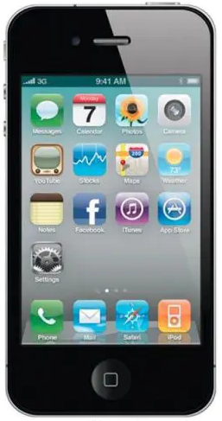
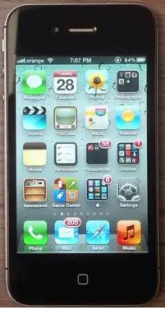
System Testing
Important traits of a good UI
iOS1-2007
iOS2-2008
iOS3-2009
iOS4-2010
iOS5-2011

Slide 23
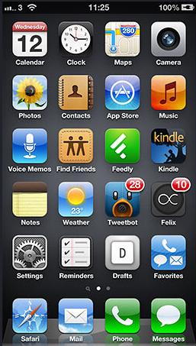
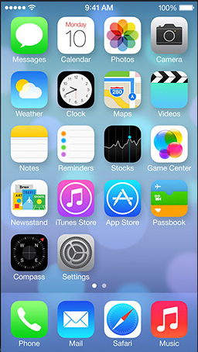
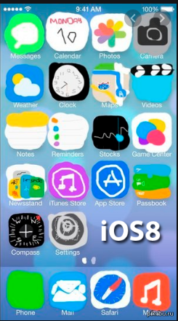
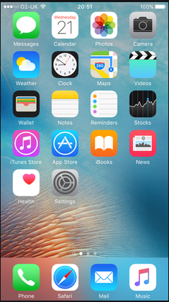
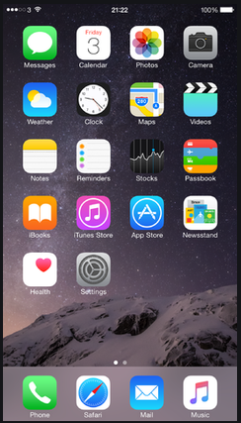
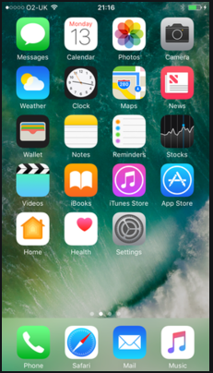
System Testing
Important traits of a good UI
iOS6-2012
iOS7-2013
iOS8-2014
iOS9-2015
iOS10-2016

Slide 24
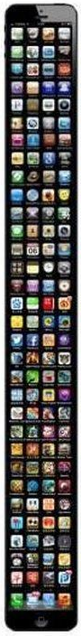
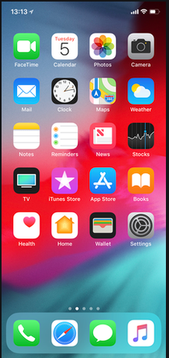
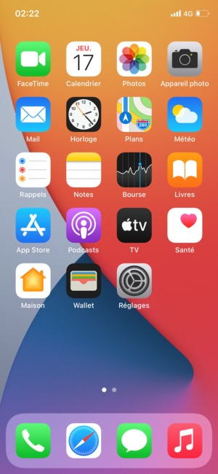
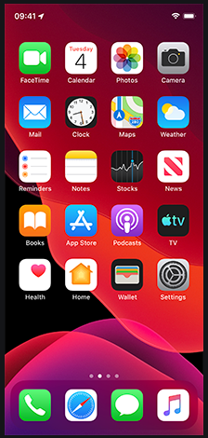
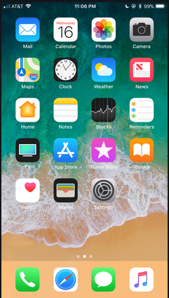
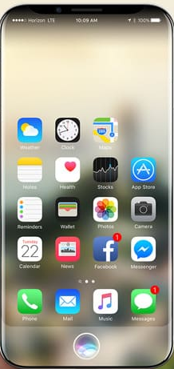
System Testing
Important traits of a good UI
iOS11-2017
iOS12-2018
iOS13-2019
iOS14-2020
iOS20?

Slide 25
System Testing
Follows UI standards and guidelines
Macintosh Human Interface Guidelines
http://developer.apple.com/documentation/UserExperience/Conceptual/OSXHIGuidelines/XHIGIntro/chapter_1_section_1.html
Microsoft Windows User Experience
http://msdn2.microsoft.com/en-us/library/aa511258.aspx
These guides detail how software that runs on each platform should look and feel to the user.
When should a check box be used instead of a button?
When is it proper to use information, warning, or critical messages?

Slide 26
System Testing
Follows UI standards and guidelines (cont’d)
The standards guidelines for a platform should be treated as an addendum to the product specification.
Test cases should be created based on the standards guidelines in addition to the test case created from the product’s specification.
If the development platform does not have a standard, the design team must create usability standards for the software itself.

Slide 27
System Testing
Intuitive UI
Is the UI clean, unobtrusive, not busy?
Are responses obvious and there when you expect them?
Is the UI organized and laid out well?
Are the inputs acknowledged?
Do the menus go too deep?
Is there excessive functionality?
Is there information overload?
Does the help system really help the user?

Slide 28
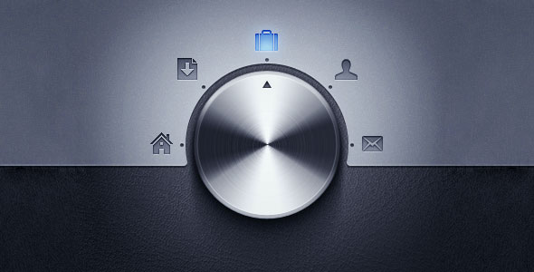
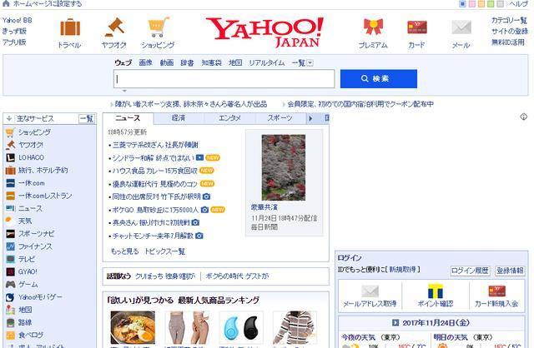
System Testing
Non-intuitive UIs

Slide 29
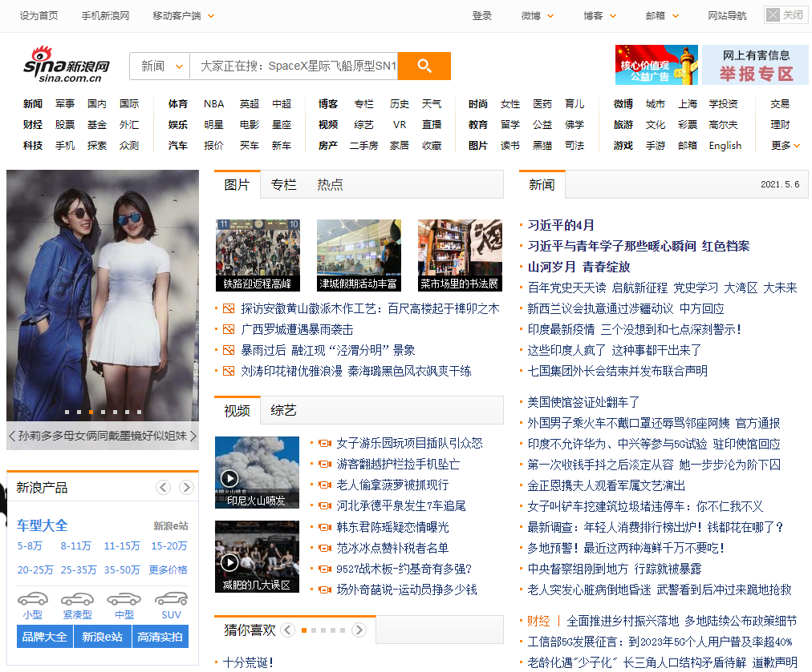
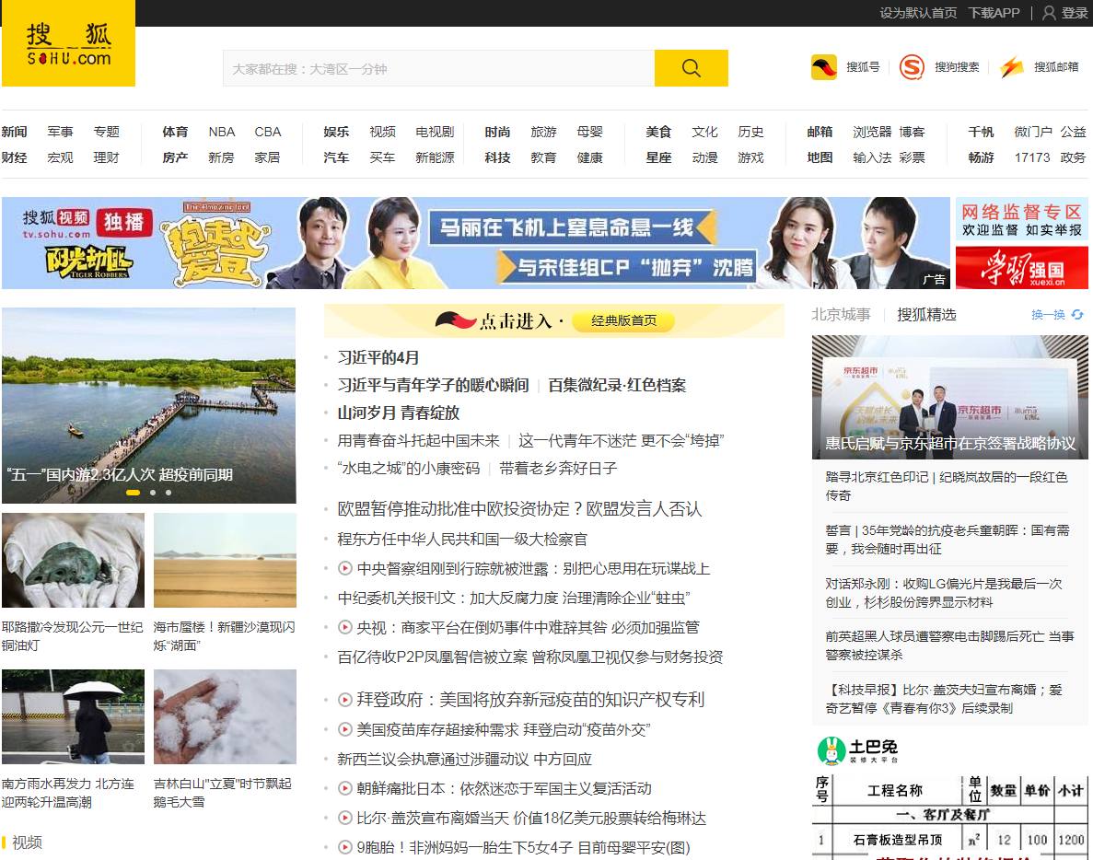
System Testing
Non-intuitive UIs

Slide 30

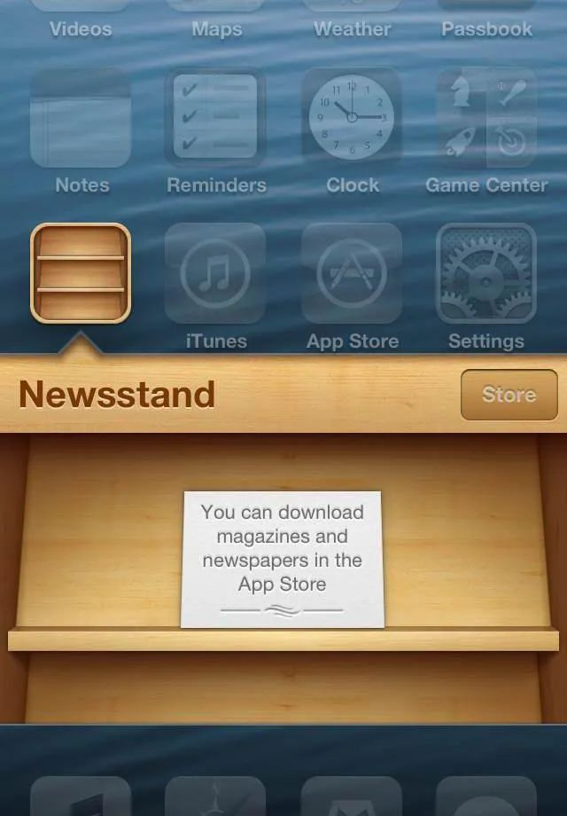
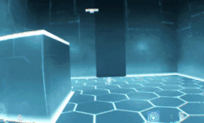
System Testing
Intuitive Ui (?)

Slide 31
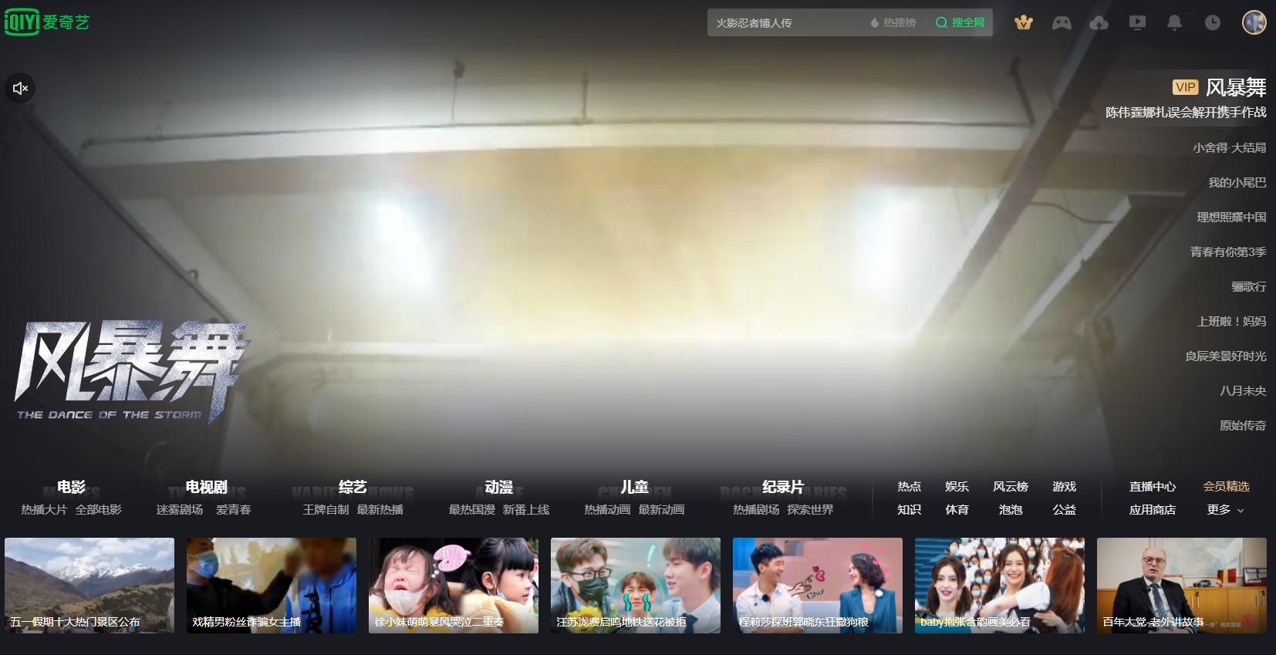
System Testing
Intuitive UI (?)

Slide 32
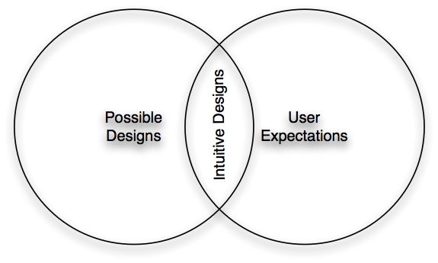
System Testing
Intuitive UI

Slide 33
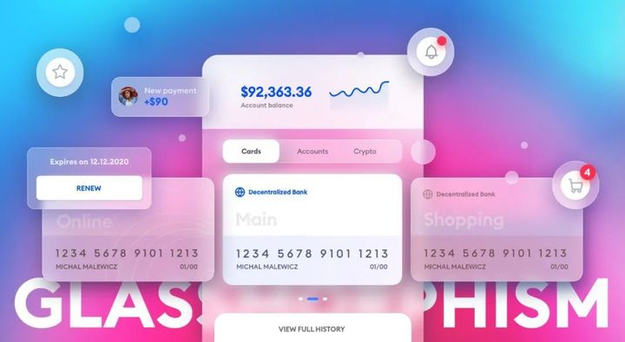
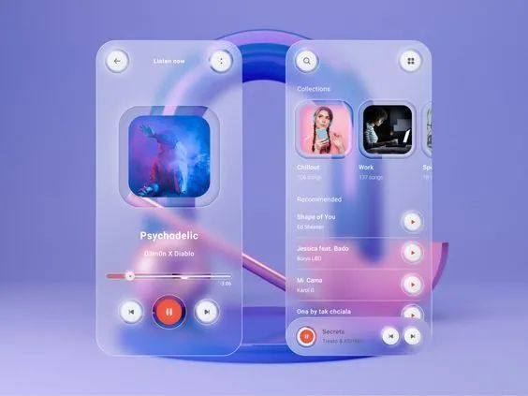
System Testing
Intuitive UI (?)

Slide 34
System Testing
Consistent UI
Shortcut keys and menu selections
F1 should always get you Help in MS Windows.
Different UI paths should have the same F key to execute a feature.
Terminology and naming
Is Find sometimes called Search?
Audience
Consider the success of the UI of the car and ATM.
Placement of buttons such as OK and Cancel
In Mac OS, the OK button is always on the right.
In MS Windows the, the OK button is on the left and Cancel is on the right.

Slide 35
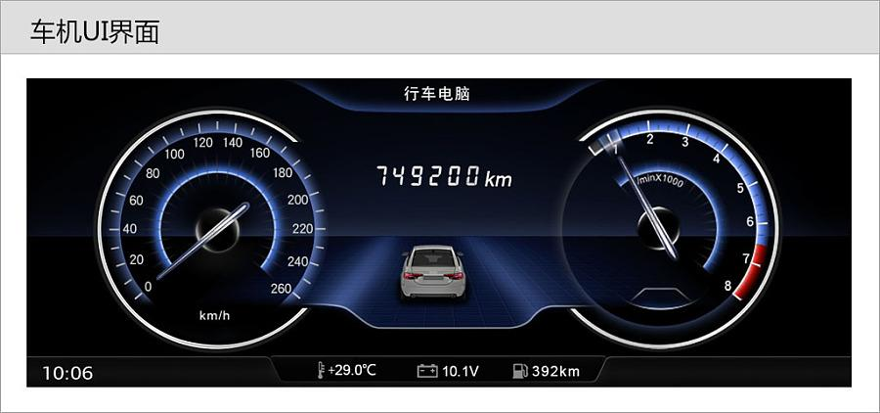
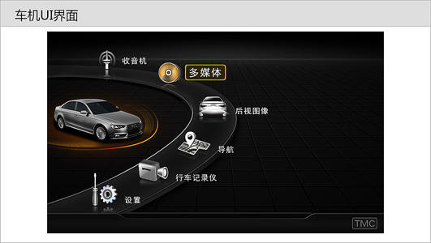
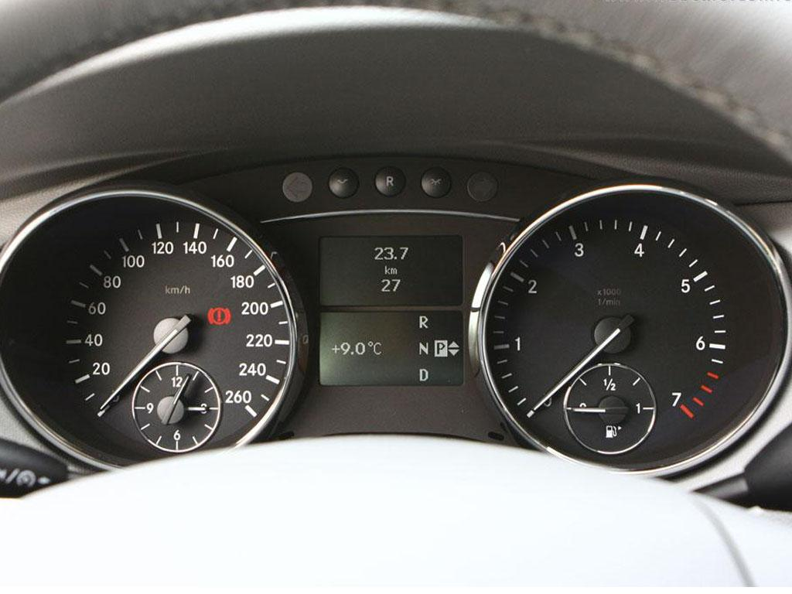
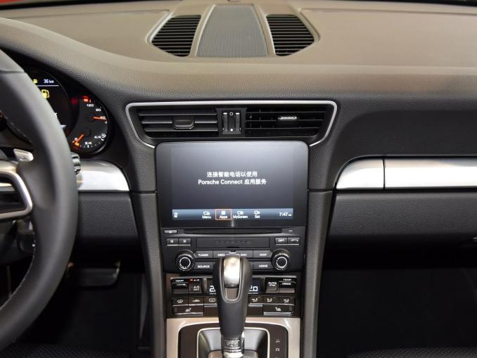
System Testing
Consistent UI

Slide 36
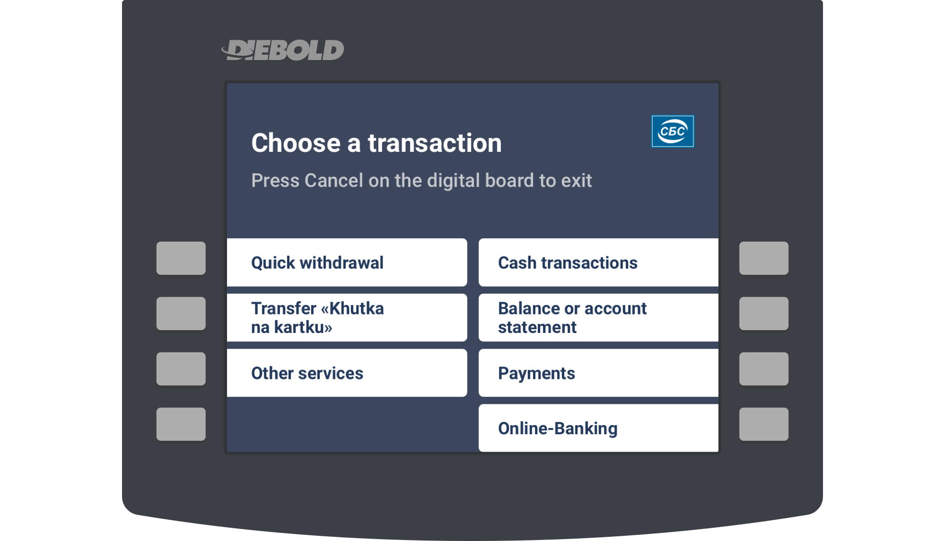
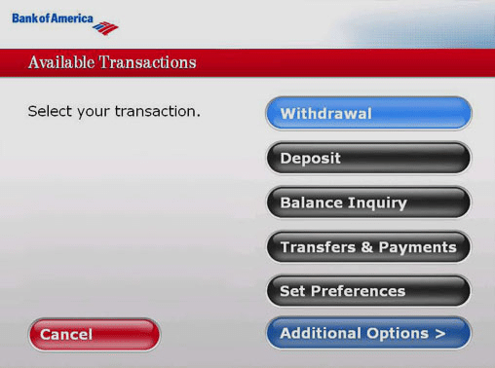
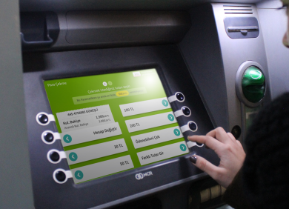
System Testing
Consistent UI

Slide 37
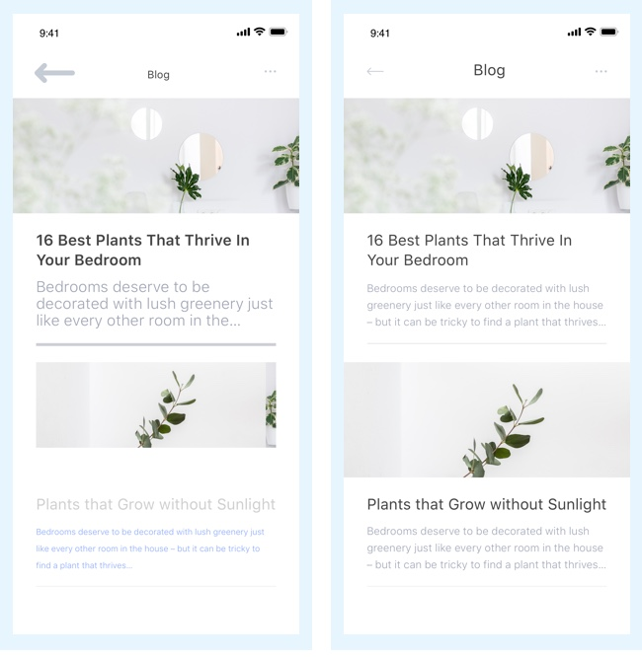
System Testing
Consistent UI

Slide 38
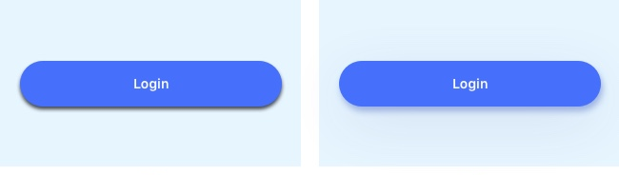
System Testing
Consistent UI

Slide 39
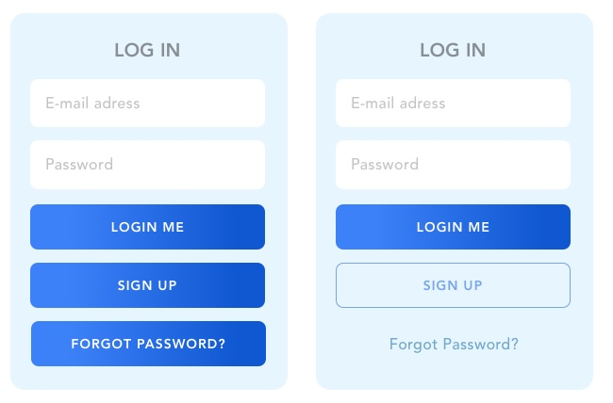
System Testing
Consistent UI

Slide 40
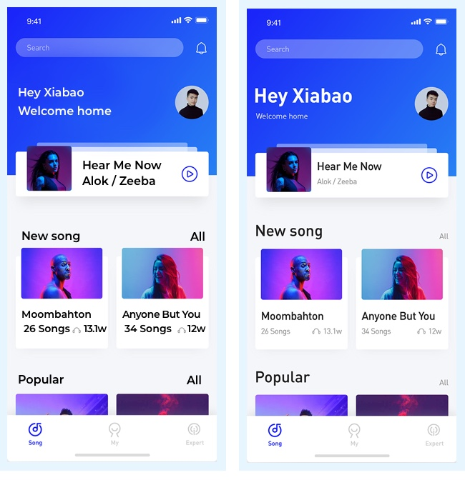
System Testing
Consistent UI

Slide 41
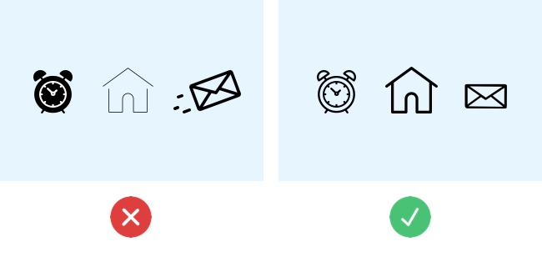
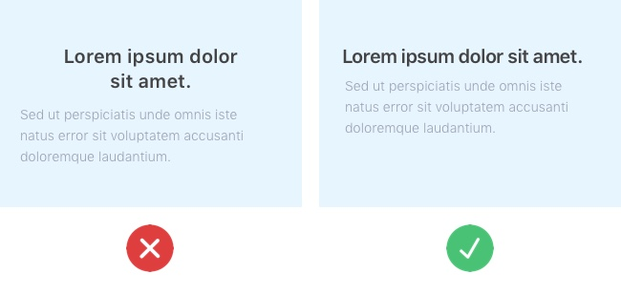
System Testing
Consistent UI

Slide 42
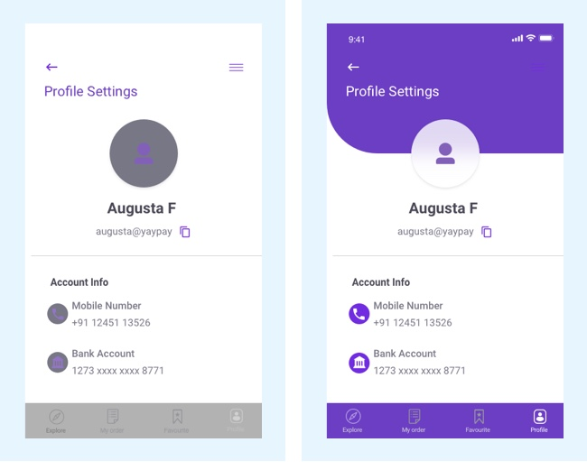
System Testing
Consistent UI

Slide 43
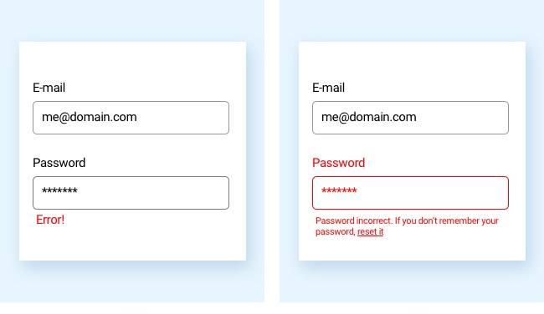
System Testing
Consistent UI

Slide 44
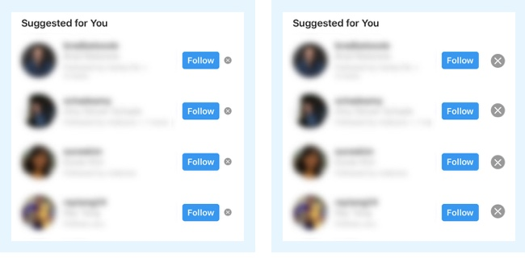
System Testing
Consistent UI

Slide 45
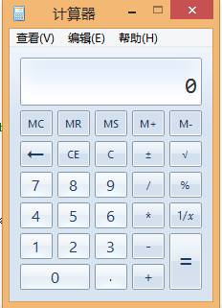
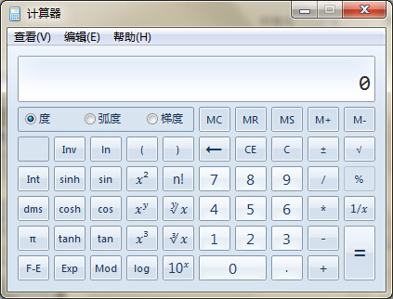
System Testing
Flexible UI
Users like choices … but not too many.
E.g., MS simple and scientific calculators
Flexible UIs provide:
State jumping
Many alternative ways to achieve the same goal.
State termination and skipping
“If you know your party’s extension enter it at any time”.
Multiple ways to perform I/O
Excel allows many input formats (from keyboard or files) and many output formats (table, graphs, charts).

Slide 46
System Testing
Comfortable UI
Sounds like a strange notion …
Is the UI appropriate?
Sound effects in a computer game? How about a business application?
Does the UI handle errors well?
If there is no Undo/Redo feature critical operations may fail.
Is the feedback fast enough or too fast?
E.g., waiting for cash to come out of the ATM
Does excessive use cause harm?
E.g., Emacs hand

Slide 47
System Testing
Correct UI
Marketing differences
Are there extra or missing functions from what the marketing material states?
Language and spelling
Error messages often have spelling mistakes
Bad media (icons, images, sounds, videos) that for with the software UI.
WYSIWYG
E.g., does the printed Adobe Acrobat file look like the one on the screen?

Slide 48
System Testing
Useful UI
When testing a UI feature, ask if the feature you see actually contributes to the software’s value.
Many applets have useless features
E.g., dancing elves
Useless UI features waste time for the user, developer, and tester.

Slide 49
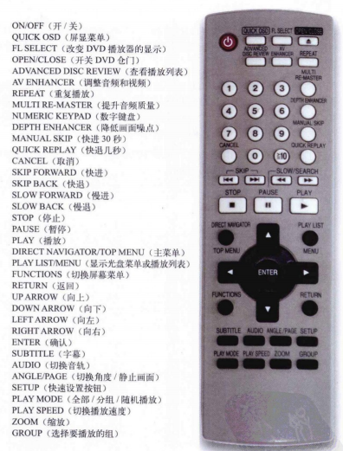
Useful UI

Slide 50




Useful UI

Slide 51

Useful UI

Slide 52


Useful UI

Slide 53
System Testing
Accessibility Testing (testing for the disabled)
Nearly 20% of American have some form of disability according to the 1997 US Census.
The following impairments make using computers especially difficult:
Visual
E.g., color blindness, tunnel vision, cataracts.
Hearing
E.g., partial or complete deafness.
Motion
E.g., injury can make using a keyboard or mouse difficult or impossible.
Cognitive and language
E.g., dyslexia or memory problems and using complex UIs

Slide 54
System Testing
Legal requirements
In the US, three laws apply to developing software with a UI that can be used by the disabled:
The Americans with Disability Act (ADA) has been applied to commercial Internet websites.
Section 508 of the Rehabilitation Act is similar to the ADA and applies to any organization that receives federal funding.
Section 255 of the Telecommunications Act requires all hardware and software that transfers information over the Internet/network/phone line be accessible to people with disabilities.

Slide 55
System Testing
Accessibility features in software
If the software being tested does not run on a platform that has specified accessibility features?
Accessibility features will have to be specified, programmed, and tested.
If your platform has built in accessibility features your software?
Software only needs to adhere to the platform’s standard for communicating with peripheral devices.
Remember to create test cases specifically to test for accessibility.
Add them to your configuration testing equivalence partitions.

Slide 56
System Testing
Microsoft Windows accessibility features
Sticky-keys: Allow Shift, Ctrl, Alt keys to stay in effect until the next key is pressed.
Filter-keys: prevents brief repeated keystrokes from being recognized.
Toggle-keys: plays tomes when Caps Lock, Scroll Lock, or Num Lock keyboard modes are enabled.
Sound-sentry: creates a visual warning whenever the system generates a sound.
Show-sounds: instructs program to display captions for any sounds or speech they make.

Slide 57
System Testing
Microsoft Windows accessibility features (cont’d)
High contrast: sets up the screen with colors and fonts designed to be read by the visually impaired.
Mouse-keys: allows the use of keyboard keys instead of he mouse to navigate.
Serial-keys: sets up a communication port to read in key strokes from an external (non-keyboard) device.

Slide 58


System Testing
Microsoft’s accessibility website

Slide 59


System Testing
Apple’s accessibility website

Slide 60
System Testing
System Testing
Example: Website Testing

Slide 61
System Testing
How to test a website
Easiest way to start is by treating the web site as a black box.
Look at a sample website such as www.apple.com to get a sense of the scale of such an endeavor.
Treat each page as a state with hyperlinks as state transitions.

Slide 62
System Testing
Website text
Web page text should be treated like documentation and tested using the techniques we described previously.
Check for …
correctness of contact information e.g., phone numbers, addresses
correctness of dates and copyright notices
title bar text, bookmark text on browser’s favorites
correctness of the ALT text (i.e., mouse over text)
layout issues when browser window is resized

Slide 63
System Testing
Website hyperlinks
Each link should be checked to make sure it jumps to the correct destination or website.
Ensure that hyperlinks are obvious:
E.g., underlined text, mouse pointer changes
If the link opens an e-mail message, test it
Send an e-mail and verify that you get a response.
Check for orphan pages that are part of the website but cannot be accesses through a hyperlink.
Someone forgot to create the link
Might be intentional … Google will find it, though

Slide 64
System Testing
Website graphics
Do all graphics load and display properly?
Is a graphic missing or incorrectly named?
Does the website intermix text and graphics?
Does the text wrap around the graphics?
What happens when the browser window is re-sized?
Does the page load fast enough?
Are there too many graphics?
Did you try to test the website on a dialup connection instead of a high-speed LAN?

Slide 65

System Testing
Website forms
Forms are the text boxes, list boxes, and other fields for entering and selecting information on the web page.
Are the form fields positioned properly?
Are the fields the correct size?
Do they accept correct data?
Do they reject bad data?
Are optional fields really optional?
A favorite entry point for buffer overflow attacks (more on this later).

Slide 66
System Testing
“Grey-box” testing
A mixture of white-box and black-box testing.
You stick to black-box testing primarily and supplement it by taking a peek at the HTML to figure out how the website works.
For website testing it is worth looking at the HTML code.
It’s there, easy to look at, why not?
Not looking at the HTML code is wasteful, especially since HTML is such a simple language.
HTML is a tagging language for text and graphics.
To create dynamic web content requires that HTML be supplemented by programming code (e.g., Java applets, ActiveX, VBScript, CGI, Perl).

Slide 67
System Testing
White-box testing
To make sure you find the important bugs you should have some knowledge of the website’s programming:
Dynamic content
Database-driven web pages
Programmatically created web pages
Server performance and loading and security

Slide 68
Dynamic content
Dynamic content is graphics and text that changes based on certain conditions.
E.g., time of day, weather, stock tickers
Client-side programming involve embedding scripting code (e.g., JavaScript) into HTML.
Less efficient if the computations are expensive
Code is local, easy to access for testing
Server-side programming is code located on the server.
More efficient for intensive calculations
Requires access to the web server to view the code (might be a problem for testing).

Slide 69
Database-driven web pages
Most E-commerce that show catalogs or inventories are database driven.
E.g., Amazon
Data is pulled from the database, formatted into HTML and sent to the web browser for viewing A three tier architecture is used:
Tier 1: web browsers (presentation)
Tier 2: web page formatter (converts data from Tier 3 to HTML)
Tier 3: database (queried by Tier 2)

Slide 70
Programmatically- Created web pages
HTML or code is generated by a program.
E.g., a web designer may drag and drop elements in a layout program, press a button, and get an HTML page.
Compilers do this all the time, except they translate high-level language code (Java source code) into low-level code that can be executed natively or on a VM (e.g., byte code).
Testing these systems is like testing a compiler …
Automation? (Selenium) (Video)

Slide 71
System Testing
Server performance loading and security
Popular websites can receive millions of hits per day.
www.youtube.com hits 100 Million Videos per day
Each hit requires a download of data from the website’s server to the browser’s computer.
You need to simulate millions of connections and downloads to test a system for performance and loading.
Security issues include:
Denial of service attacks
Buffer overflow attacks

Slide 72
Configuration and compatibility testing
Hardware platform
Mac, PC, PDA, WiFi wristwatch?
Browser software version
Firefox 1.0, IE 6.0, Pocket IE, Netscape 7.2, Safari 2.0.4
Browser plug-ins
To play specific types of audio or video files
Browser options
Security options, ALT text, plug-in, pop ups
Video resolution and color depth
640x480, 800x600, 1024x768, 1280x1024, 256 colors, 16 colors
Text size
Small fonts, medium fonts, large fonts
Connection speed
DSL, modems of varying speed.

Slide 73
System Testing
Usability testing: Jacob Nielsen’s top 10 mistakes in web design
Gratuitous use of bleeding-edge technology
Scrolling text, marquees, and constantly running animations
Long scrolling pages
Non-standard link colors
Outdated information (need website maintenance)
Overly long download times (more than 10 sec to load)
Lack of navigation support
Orphan pages
Complex website addresses (URLs)
Using Frames (just open another window …)

Slide 74
System Testing
Website testing tools
Check out www.netmechanic.com
Website testing is very labor-intensive.
Tools that automatically check websites for:
Browser compatibility
Performance problems
Broken hyperlinks
HTML standard adherence
Spelling on text

Slide 75
System Testing
Web applications
Website - requests are navigational requests.
Web Application - requests can affect the state of the business logic on the server.
Client
Browser
A
Web Server
B
Scripts and Application
Server
C
Database
Server
F
E
D
A: Request
B: Request for page generation
C: SQL command
D: Result set
E: Dynamically generated page
F: Response (dynamic | static page)

Slide 76
System Testing
Web application failures
A 2003 study by the Business Internet Group of San Francisco found that:
72% (29/40) leading e-commerce sites, and
68% (28/41) government sites contained Web application failures
25 “technical errors”
E.g., page not found, multiple attempts to subscribe to a service
3 data errors
E.g., page without text, wrong page returned

Slide 77
System Testing
What type of bugs? Study by Kallepalli and Tian [IEEE TSE].
Analyzed the logs of the Web pages of Southern Methodist University for usage and failure information.
Looked at data from 26 consecutive days.
Total number of “hits” 762,971 (~30,000 hits/day)
A “hit” is registered for each Web page if one of the following happens:
The HTML file corresponding to a page is requested.
Any graphics within the HTML page is requested.

Slide 78
Bug types
Permission denied
No such file or directory
Stale NFS handle
Client denied by server configuration
File does not exist
Invalid method in request
Invalid URL in request connection
Mod_mime_magic
Request failed
Script not found or unable to start
Connection reset by peer
2079
14
4
2
28631
0
1
1
1
27
0

Slide 79
System Testing
About the bugs
“Permission denied”
Unauthorized access to restricted resources
Is this a bug?
“File does not exist”
Wrongfully denied access to restricted or unrestricted resources e.g., wrong file access code

Slide 80
Load Testing Tools (From Abraham Jacob)
Microsoft's web application stress tool | 0
Cyrona's OpenSTA | 1
Quest Software's benchmark factory | 4
Empirix's E-Test Suite 6.0 | 6
RadView's WebLoad 5.0 | 7
IBM Rational Robot | 7
HP Mercury LoadRunner | 8
Compuware's QA Load 4.7 | 10
Segue Software's SilkPerformer 5.0 | 10+
Best

Slide 81




Test Tools

Slide 82
To be continued… See you next week

